Slide 1
PLASMA DONAR APPLICATION
TEAM ID : PNT2022TMID08318
IBM-Project-14173-1659543653

Slide 2
CONTENTS :
ABSTRACT & OVERVIEW
SOFTWARE & SYSTEM REQUIREMENTS
INSTALLATIONS
ARCHITECTURE OF THE PROJECT
IBM CLOUD SETUP & SERVICES
WEB APP
CODE
COMMANDS
REFERANCES

Slide 3
ABSTRACT & OVERVIEW
During the COVID 19 crisis, the requirement of plasma became a high priority and the donor count has become low. Saving the donor information and helping the needy by notifying the current donors list, would be a helping hand. In regard to the problem faced, an application is to be built which would take the donor details, store them and inform them upon a request.

Slide 4
SOFTWARE & SYSTEM REQUIREMENTS
Software Required:
Python, Flask , Docker
System Required:
8GB RAM,Intel Core i3,OS-Windows,Laptop or Desktop

Slide 5
INSTALLATIONS :
Python 3.9
Python Packages
Flask
ibm_db
sendgrid
python-dotenv
IBM Cloud CLI
IBM Cloud CLI – Extensions
container-registry
container-service
Kubectl

Slide 6
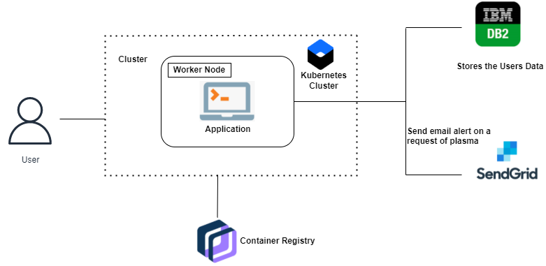
ARCHITECTURE OF THE PROJECT

Slide 7
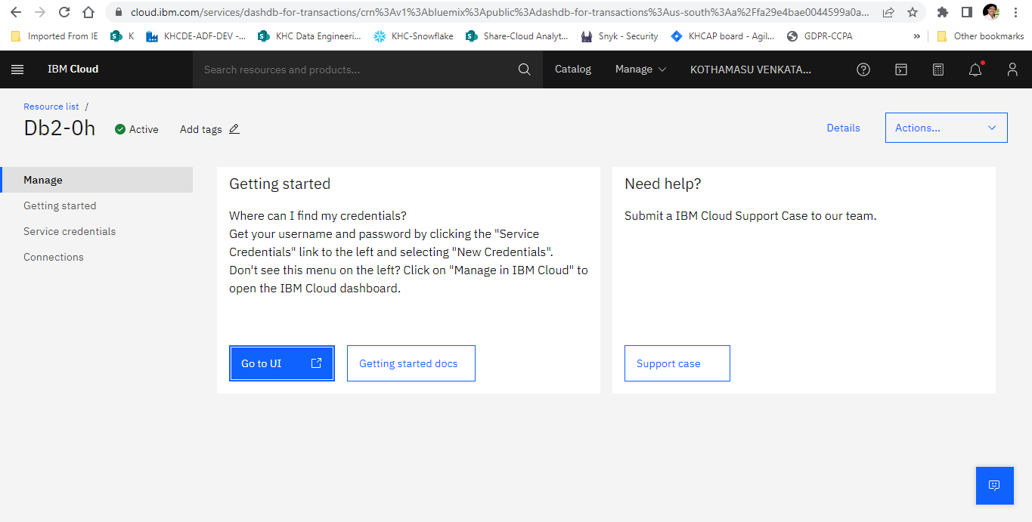
IBM CLOUD SETUP & SERVICES
DB 2 – Database:

Slide 8
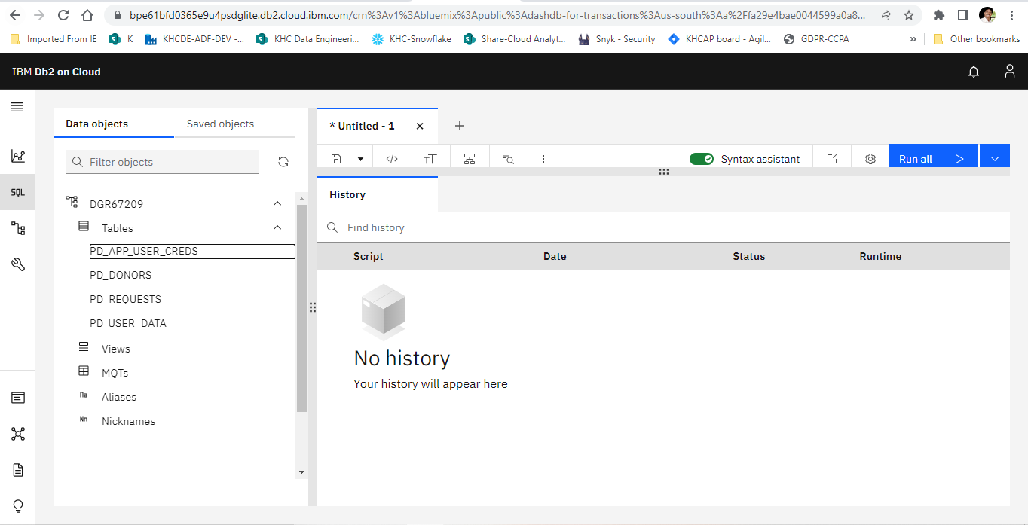
DB 2 – Database Tables:

Slide 9
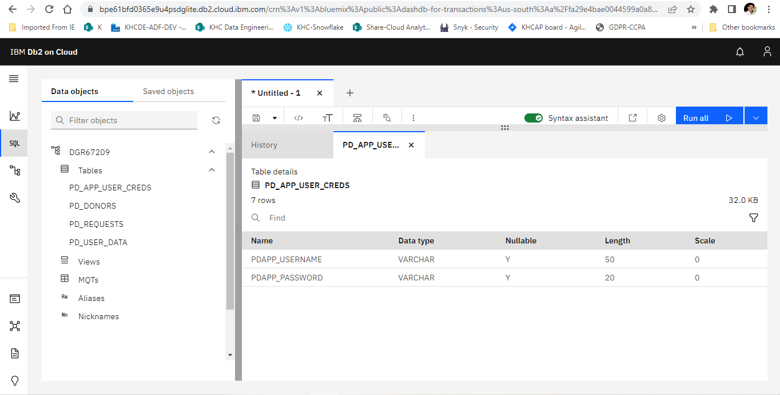
DB2 – Table - PD_APP_USER_CREDS:

Slide 10
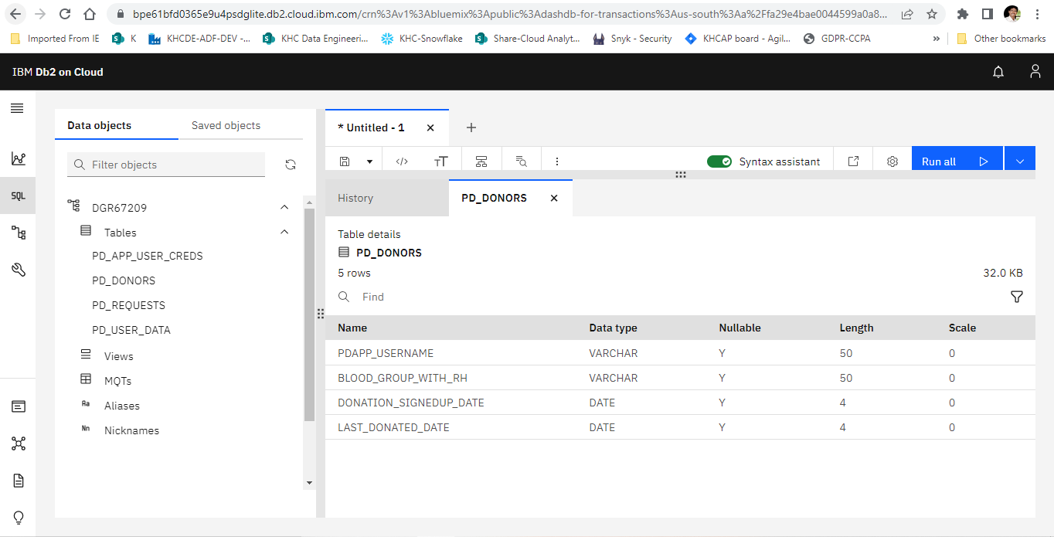
DB2 – Table - PD_DONORS:

Slide 11
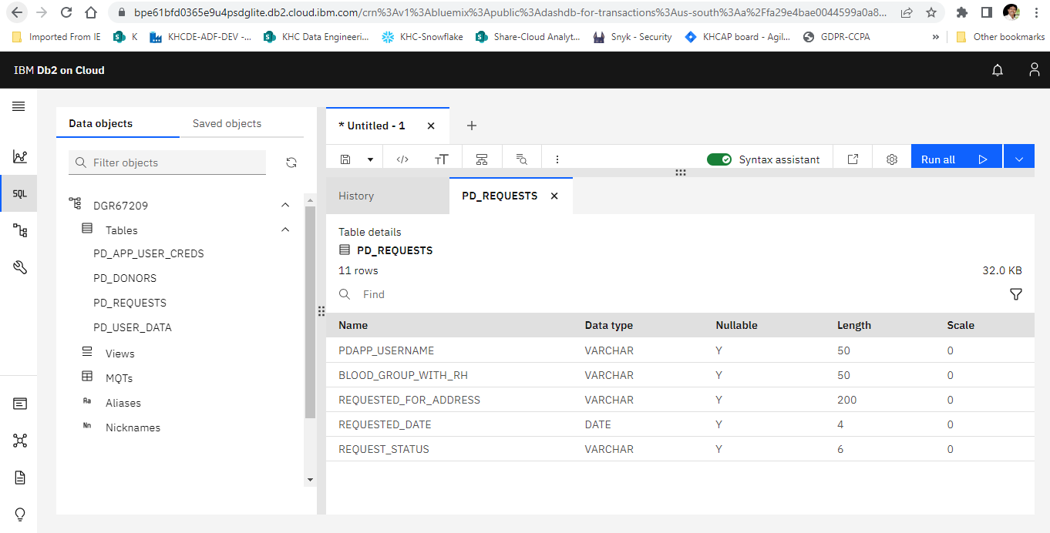
DB2 – Table - PD_REQUESTS:

Slide 12
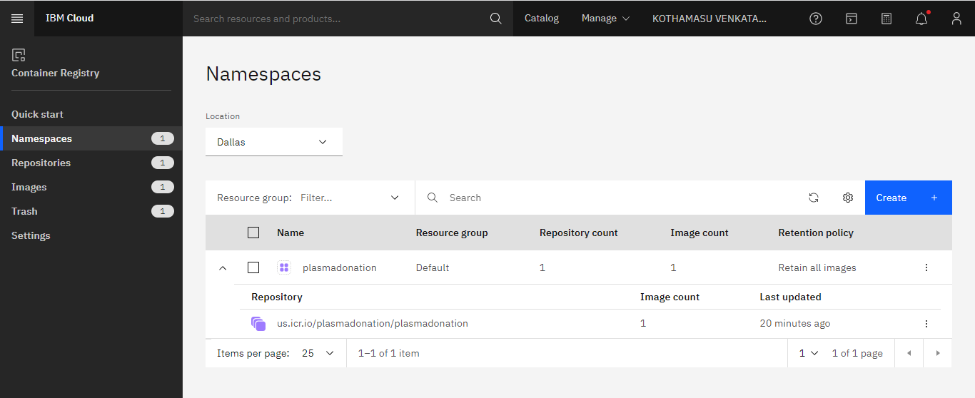
Container Registry:

Slide 13
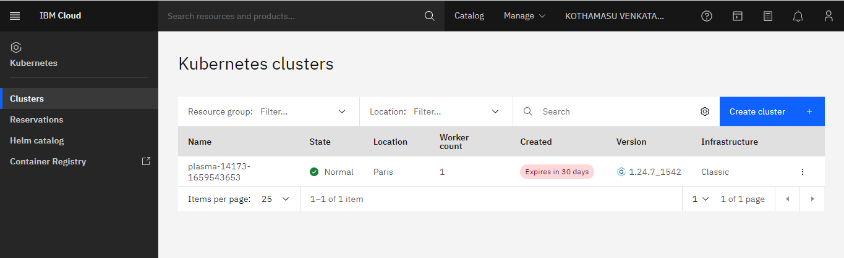
Kubernetes Cluster:

Slide 14
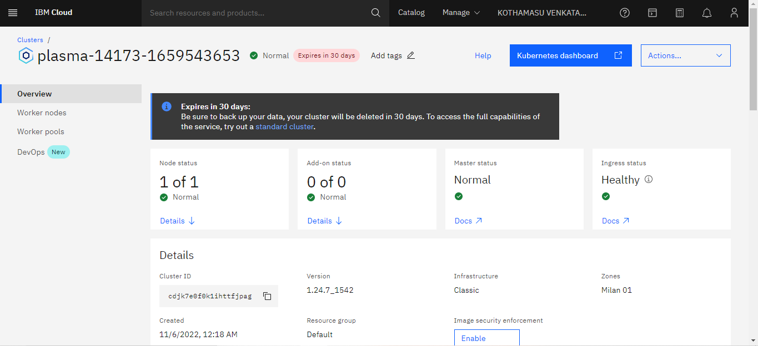
Cluster Overview:

Slide 15
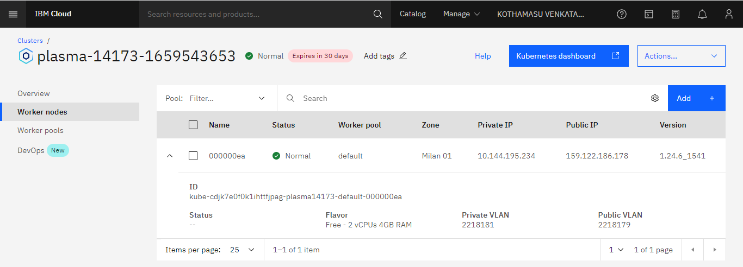
Worker Nodes:

Slide 16
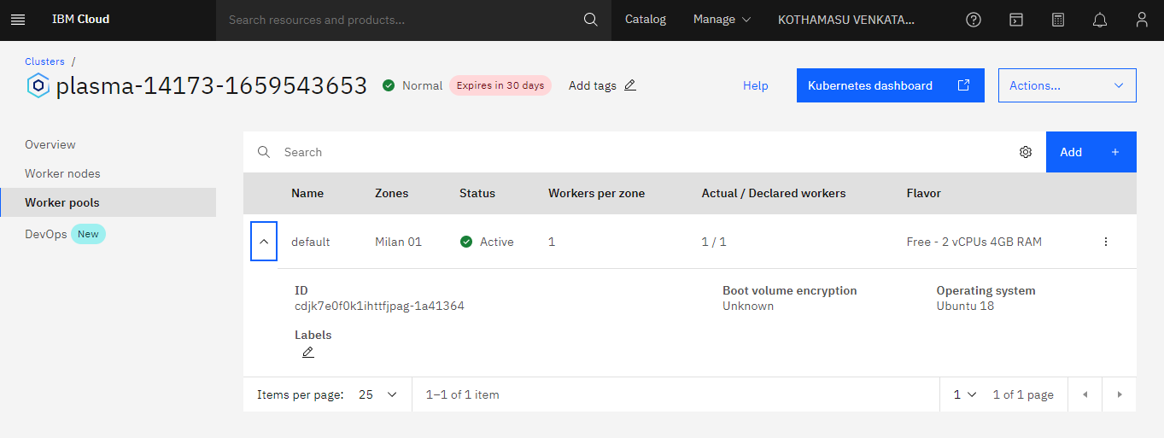
Worker Pods:

Slide 17
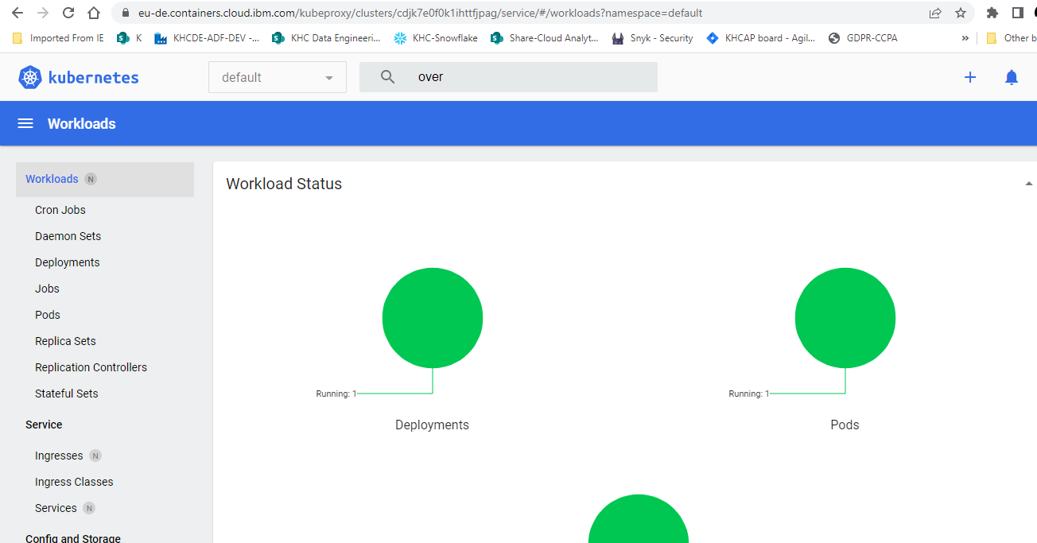
Kubernetes Dashboard:

Slide 18
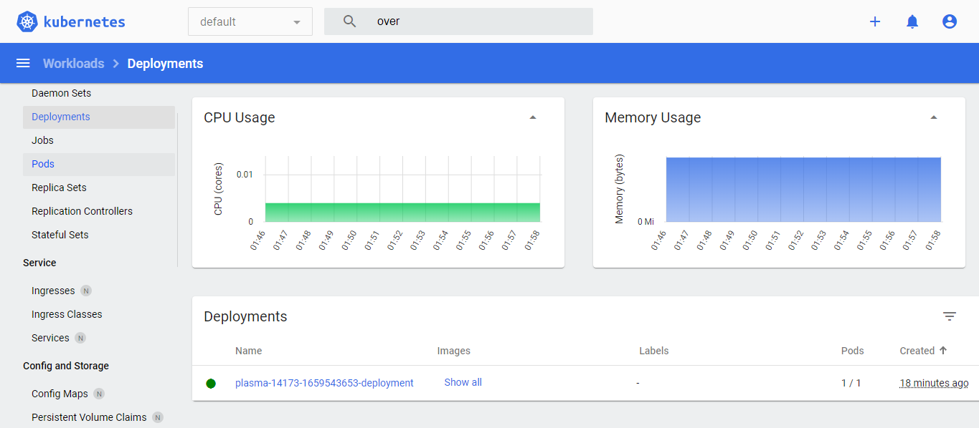
Deployment:

Slide 19
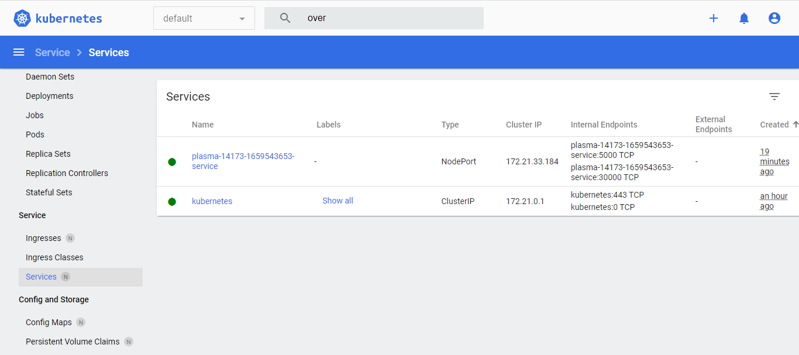
Service:

Slide 20
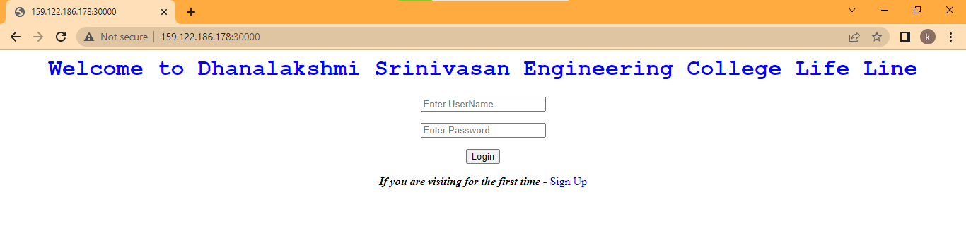
WEB APP
LANDING PAGE

Slide 21
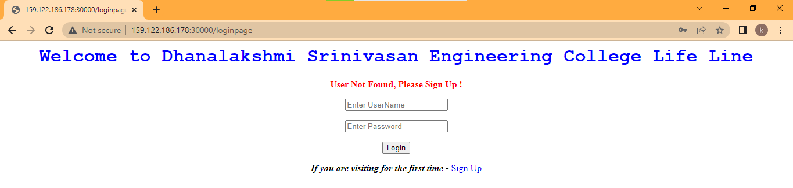
User Validation:

Slide 22

User Password Validation:

Slide 23
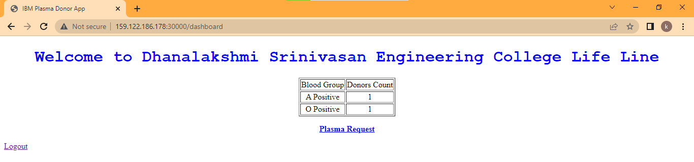
Successful Login / Dashboard:

Slide 24
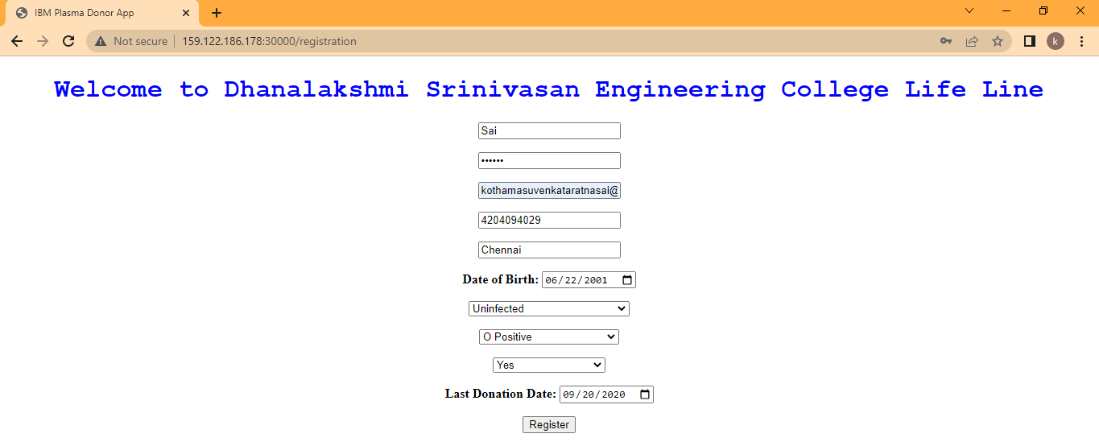
User Registration:

Slide 25
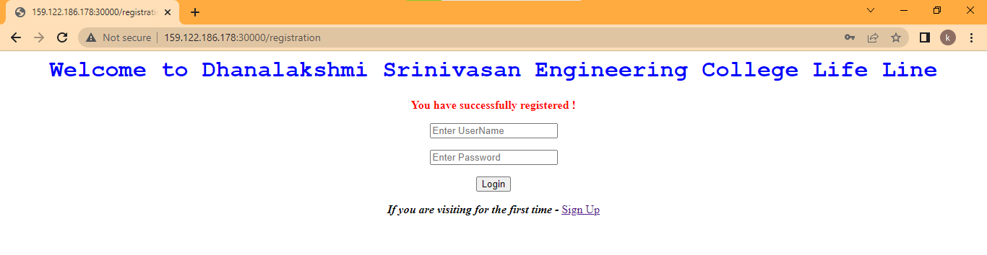
User Successful Registration:

Slide 26
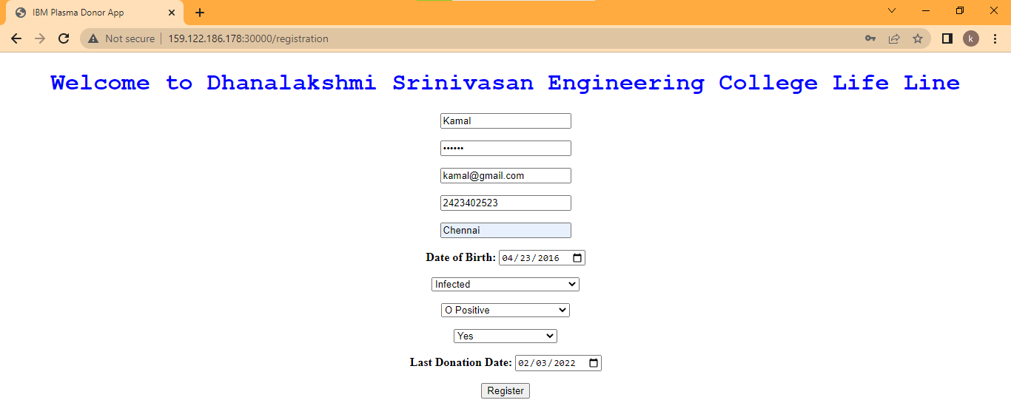
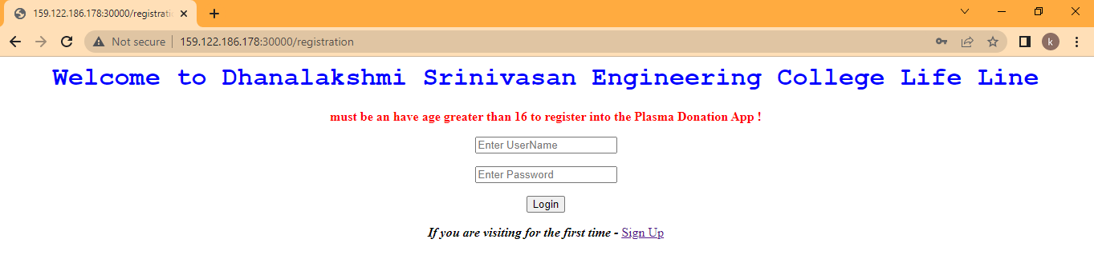
User Registration – Age Validation:

Slide 27
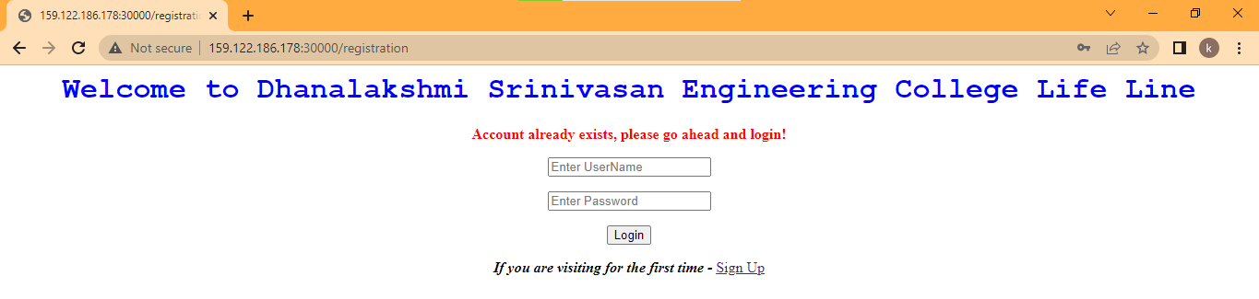
User Registration – Duplicate Registration:

Slide 28
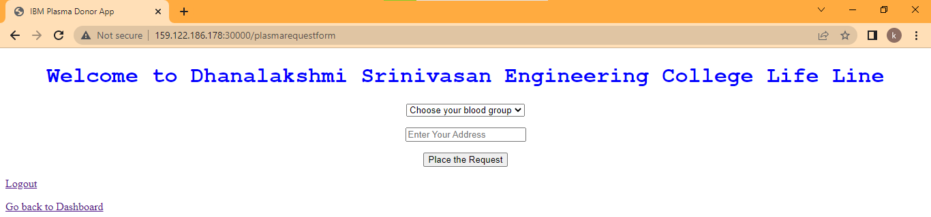
Plasma Request Form:

Slide 29
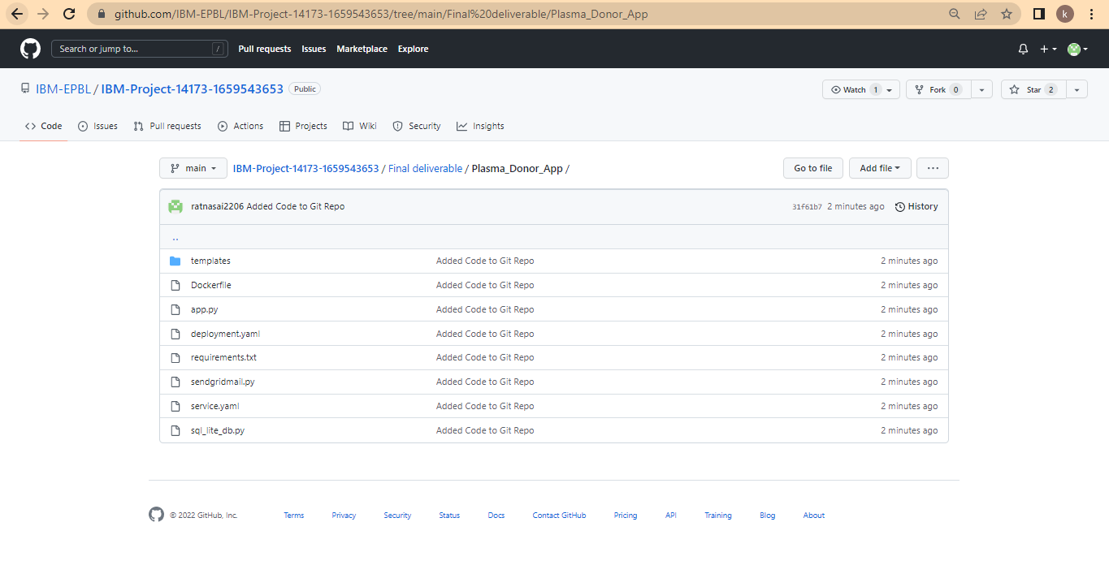
CODE:

Slide 30
CODE IMPLEMENTATION
Implimentation link http://159.122.186.178:30000/

Slide 31


